Slide 2
Department Majors
B.S. Agribusiness
B.S. Agricultural Economics
Allows students to choose from four different focuses, tailoring their degree to their career interests.
Prepares students for careers in the agriculture by creating networking events with a number of field specialists.
Offers four minors.
Provides a comprehensive knowledge of standard business practices while addressing the unique facets of agriculture
Prepares students for careers in both agricultural and non-agricultural sectors.
Includes courses from Mays Business School
Highly competitive

Slide 3
Financial Planning Minor
What do financial planners do? Glad you asked!
Financial planners advise their clients about financial decisions, including budget management, insurance, investment, taxes, retirement, and estate planning.
The Texas A&M Financial Planning Program is a CFP Board Registered Program.
Students that complete the program will be eligible to sit for the CFP® Certification Exam.
We pride ourselves in preparing students for leadership roles within the profession and competitive and skilled financial planners.
financialplanning.tamu.edu

Slide 4
Agriculture Economics Minor
The primary educational objective of this minor program is to provide student, majoring in other fields, with a fundamental knowledge of the fields of agricultural economics.
The courses required for this minor will cover the major business elements of the agricultural industry.
http://agecon.tamu.edu/undergraduate/undergraduate/currrent-student/resources/

Slide 5
Agribusiness Entrepreneurship Minor
Do you want to own your own business? Be your own boss? If yes, this minor is for YOU!
The courses behind this minor will give students a working knowledge of business development practices and strategies to achieve working for an entrepreneur in either a rural or metropolitan setting.
Allows students to hands on experience in building a business from the ground up.
Questions should be directed to Dr. Ed Rister by email at e-rister@tamu.edu

Slide 6
Agrifood Sales Minor
Minor will benefit students that are either: planning to launch their career in professional sales in the Agrifood Industry, need to possess the skill of building professional relationships with customers in firms, or need an understanding of the process of best practices in professional sales.
Professional sales positions and management of salespeople are not limited to one field/degree area.
http://agecon.tamu.edu/undergraduate/undergraduate/currrent-student/resources/

Slide 8
Aggie Reps A group of students operating as the middle man between the staff and the student body. Whether it be designing merchandise, answering questions from perspective students, or hosting luncheons for our staff and students, Aggie Reps are the face of the department.
AGEC Quiz Bowl
A team of individuals devoted to growing their knowledge of the industry and facets of agribusiness. These students travel to competitions and pride themselves in representing Texas A&M. For more information contact Dr. Menzies at d-Menzies@tamu.edu.
And more!!
Ag Econ Society
This is a professional and social organization focused on career development and provides students with chance to improve upon their networking skills. Frequented by industry professionals, students get exposed to a number of career opportunities.
PSSA
This professional sales association brings in working sales representatives to advise students on how to prepare for post grad life as well as improves upon the art of selling yourself and interview strategies. This organization helps students launch their career in sales.

Slide 9
Study abroad with us!

Slide 10
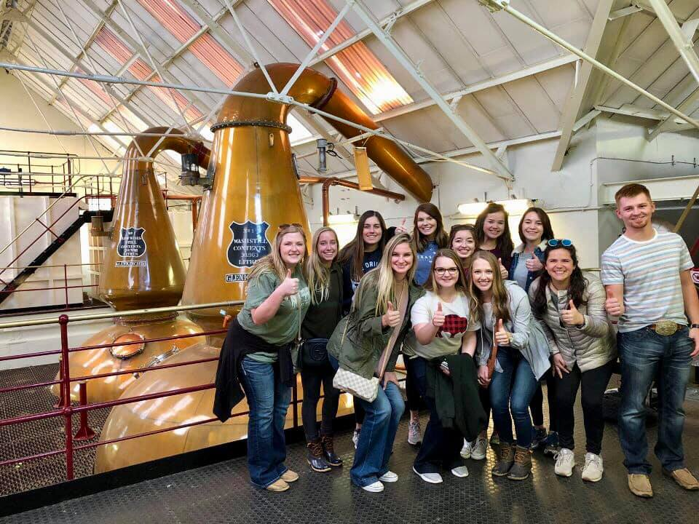
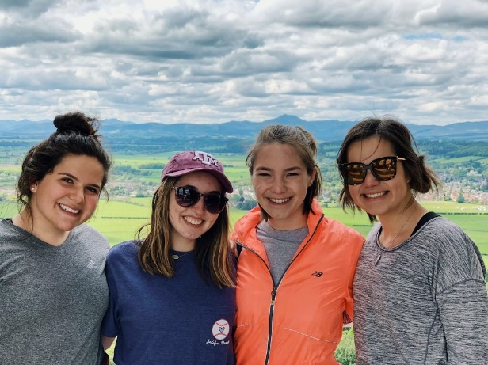
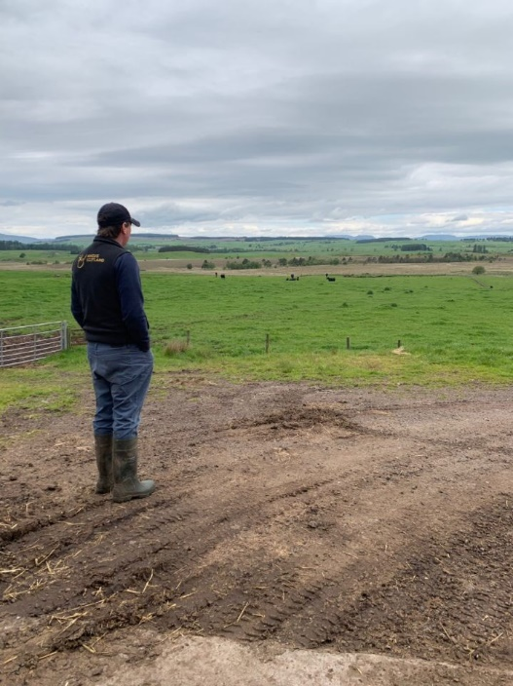
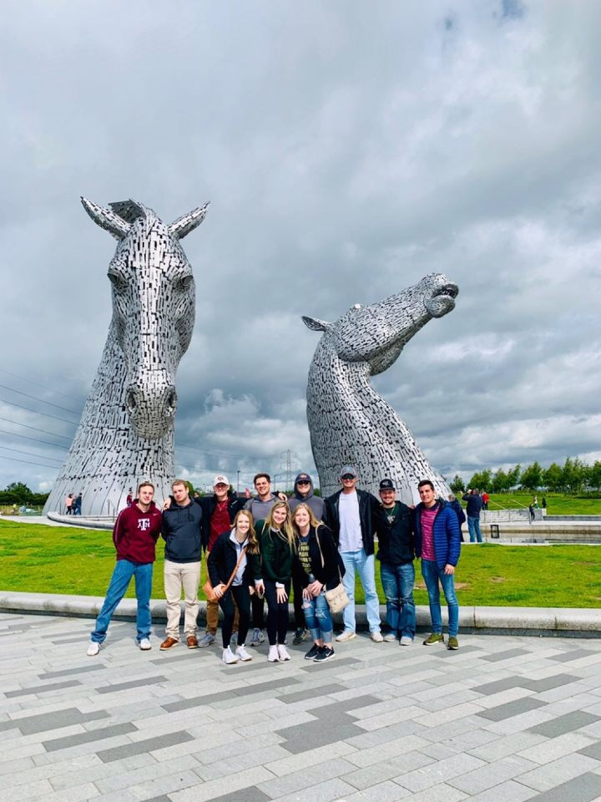
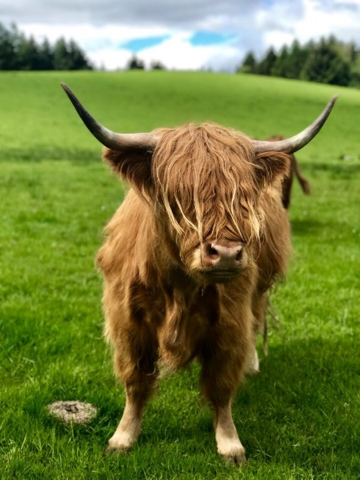
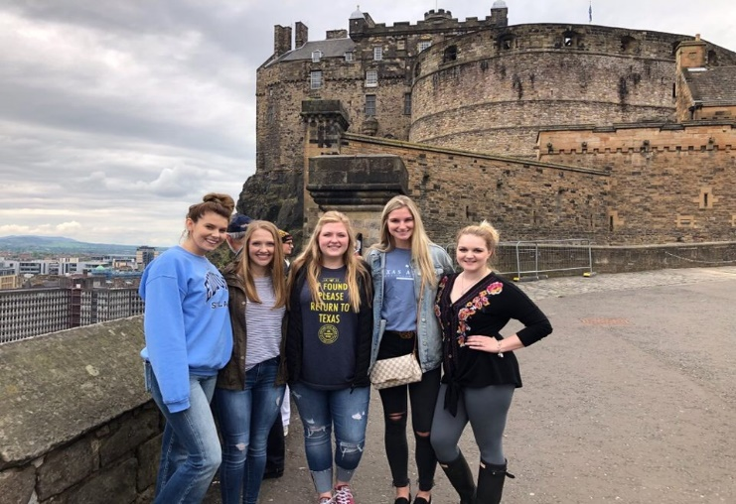
Scotland

Slide 11
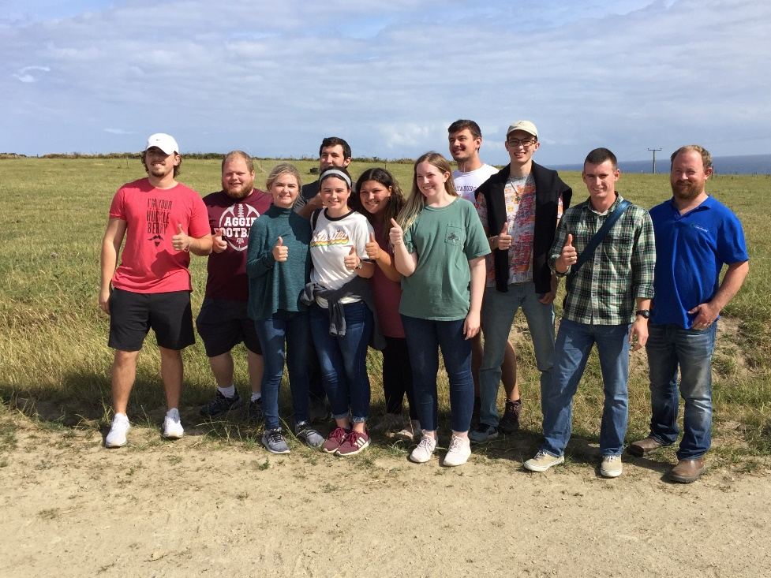
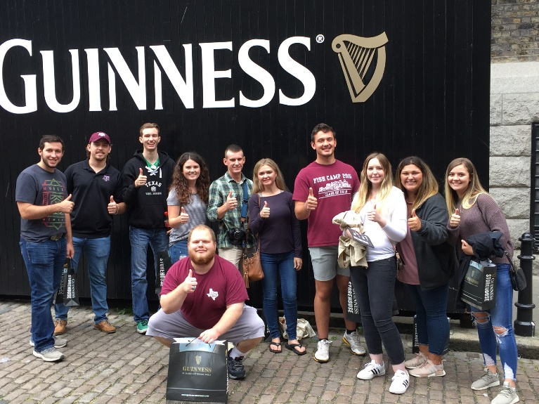
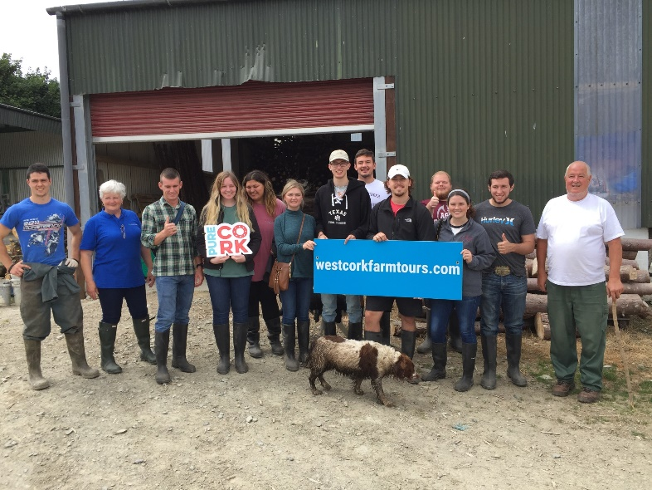
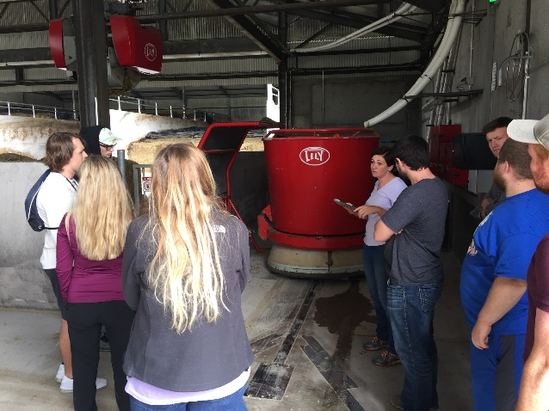
Ireland

Slide 12
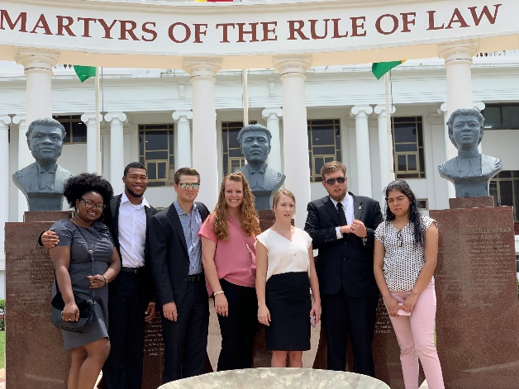
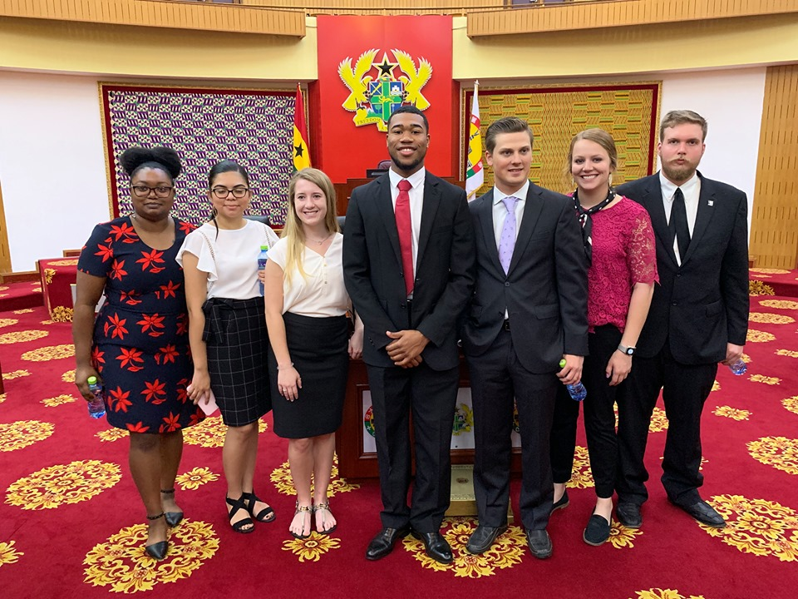
Ghana

Slide 13
http://agecon.tamu.edu/undergraduate/undergraduate/current-students/honors/
The Agricultural Economics
Honors Program
Click here for more information.

Slide 14
AGEC Express
Our weekly newsletter designed to keep students up to date on activities within the department including:
Scholarships
New programs
Internship opportunities
Upcoming events
And more!
If you have an announcement you would like included in the newsletter, email JDJDJDJDJ

Slide 15
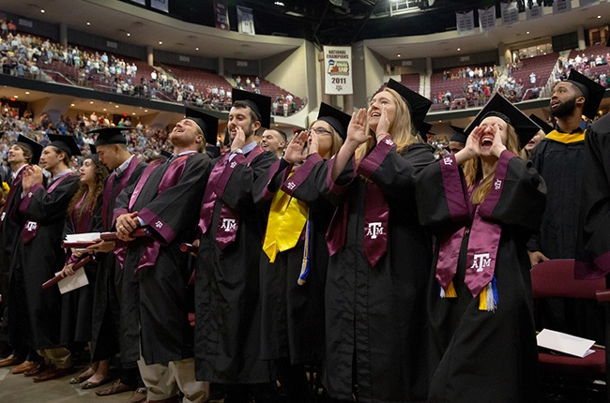
Graduating soon?
Make sure to look at the graduation checklist!
http://agecon.tamu.edu/undergraduate/wp-content/uploads/sites/2/2019/06/GRADUATION-CHECKLIST-August-2018.pdf
Click HERE for more information

Slide 16
Master of Public Service and Administration Program
A joint degree program that will allow Agricultural Economics majors to enter the Bush School during their fourth year at Texas A&M.
Students would receive their Bachelor’s Degree in Agricultural Economics and a Master’s Degree in Public Service and Administration (MPSA) in 5 years.
Ranks among the top programs of public affairs in the country!

Slide 17
Looking for a force request?
Click here for the form!
https://docs.google.com/forms/d/e/1FAIpQLSe7jwbDWIWFrr8x94tDt7pZnqsHAuGOKdVz7Dp1mr7wa78sMg/viewform

Slide 18
Transferring into our department?
http://agecon.tamu.edu/undergraduate/undergraduate/future-students/on-campus/
Click here for more information regarding off-campus transfer requirements.

