Slide 1
May 2021 Graduation Survey
May 2021 Graduation survey

Slide 2
Gender
Answer | % | Count
Male | 63.43% | 137
Female | 36.57% | 79
Total | 100% | 216

Slide 3
Major (and option if AGEC):
Answer | % | Count
AGEC - RUE | 6.48% | 14
AGEC - PEA | 10.19% | 22
AGEC - FRE | 43.06% | 93
AGEC - FMS | 12.96% | 28
AGBU | 27.31% | 59
Total | 100% | 216

Slide 4
How did you enter into the Department of Agricultural Economics?
Answer | % | Count
Freshman | 24.07% | 52
On-campus change of major | 31.94% | 69
Off-campus transfer | 43.98% | 95
Total | 100% | 216

Slide 5
Did you earn a certificate (s)?
Answer | % | Count
Yes | 23.61% | 51
No | 76.39% | 165
Total | 100% | 216

Slide 6
What are your plans after graduation?
Answer | % | Count
Accepted permanent employment | 27.78% | 60
Accepted into graduate or professional school | 12.96% | 28
Still Seeking Employment | 43.06% | 93
Military | 1.39% | 3
Other | 10.65% | 23
Total |  | 216

Slide 7
What type of job will you be taking?
Answer | % | Count
Ag Producer | 7.46% | 5
Analyst | 1.49% | 1
Banking/Finance | 14.93% | 10
Construction Industry | 7.46% | 5
Consultant | 1.49% | 1
Management | 7.46% | 5
Marketing | 1.49% | 1
Public Service | 0.00% | 0
Real Estate/Appraiser | 10.45% | 7
Sales | 28.36% | 19
Other | 17.91% | 12

Slide 8
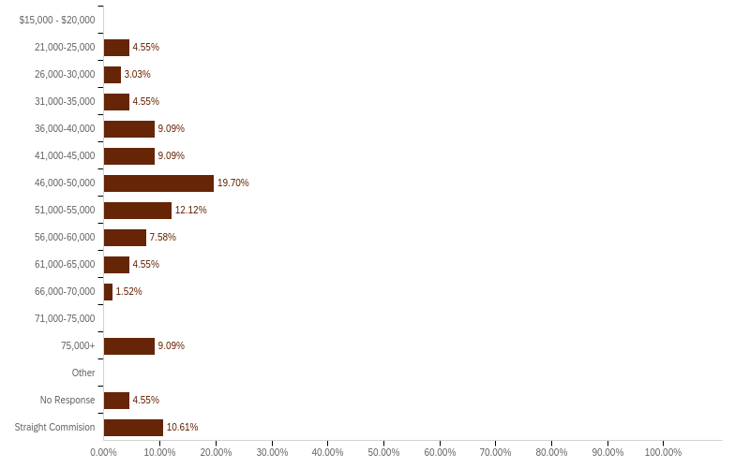
Salary Range:

Slide 9
Did you participate in a Study Abroad Program?
Answer | % | Count
Yes | 12.96% | 28
No | 87.04% | 188
Total | 100% | 216

Slide 10
Where did you go in your study abroad program?
Where did you go in your study abroad program?
United Kingdom and Ireland
South Africa
Sevilla, Spain
Scotland
Rome

Slide 11
Did you participate in an internship program?
Answer | % | Count
Yes | 37.21% | 80
No | 62.79% | 135
Total | 100% | 215

Slide 12
Were you involved in any clubs or organizations at the college or University level?
Answer | % | Count
Yes | 63.08% | 135
No | 36.92% | 79
Total | 100% | 214

Slide 13
Were you involved in any clubs in the Department of AGEC?
Answer | % | Count
No | 69.01% | 147
Yes | 30.99% | 66
Total | 100% | 213

Slide 14
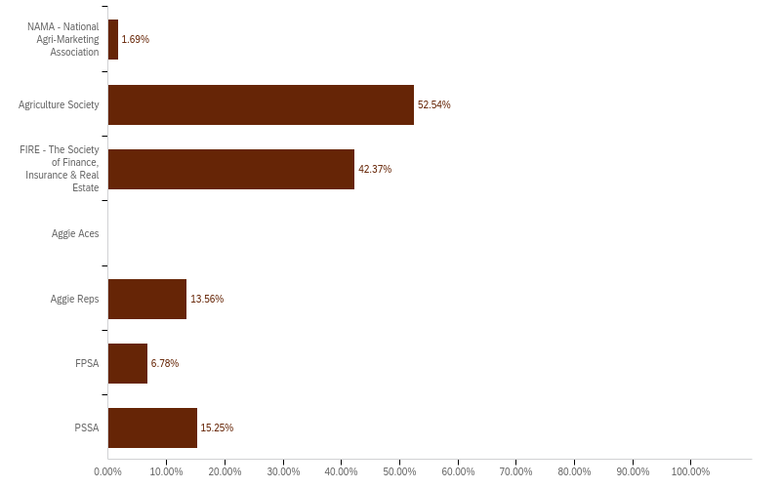
Which Departmental Clubs did you participate in?

Slide 15
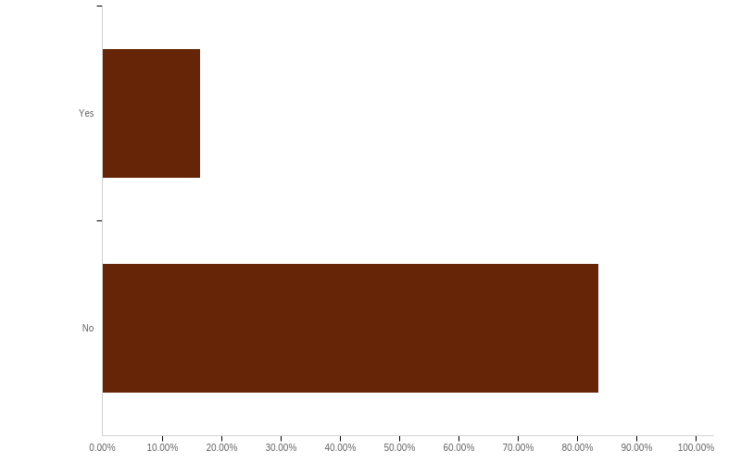
Did you hold an officer position or leadership role in any of the above clubs?

Slide 16
Did you participate in any professional organizations, undergraduate research projects, or attend any professional meetings?
Answer | % | Count
Yes | 23.26% | 50
No | 76.74% | 165
Total | 100% | 215

Slide 17
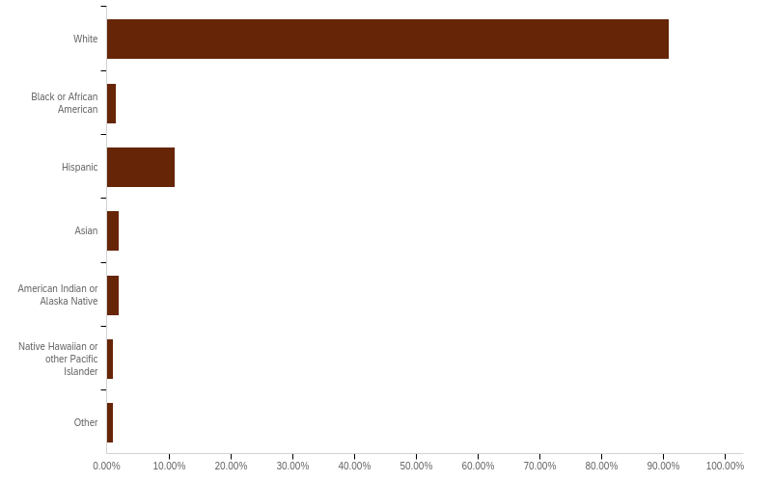
Please select the ethnic category or categories with which you most closely identify. Check as many as apply.

Slide 18
Please comment on your overall educational experiences at Texas A&M and the Department of Agricultural Economics
Please comment on your overall educational experiences at Texas A&M and the Department of Agricultural Economics - please include areas you feel were important and those that might be improved.
This department has had a significant impact on my academic and professional career. I am deeply grateful for the opportunity given to me through this program. Thank you so so much.
This could have not prepared me any better for the real world. I am beyond grateful for all the opportunities presented to me and for the knowledge I have acquired here. Some of the classes were very repetitive to where it felt like I was wasting some time every semester.
There was no better university or department that I could have learned and grown through. With supportive mentors, faculty, and peers, I was pushed to accomplish and learn more than ever imagined. The student organizations, available student worker positions, study abroad, and internships allowed me to be competitive as I move to the next step in my career.

